Slide 1

Electricity Demand and Price Forecasting
"Empowering Smarter Energy Choices with Accurate Demand and Price Forecasts!"
Mentor : Mr Lokesh Kumar Sir

Slide 2





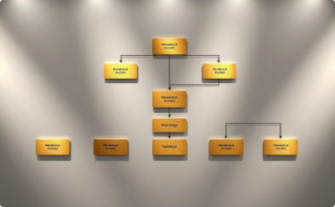



Contents
Introduction
Problem Statement
Solution Overview
Tech Stack
Workflow
Key Features
Future Scope
Conclusion

Slide 3

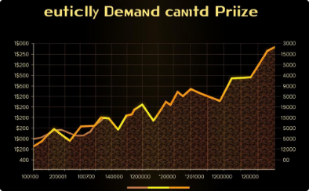
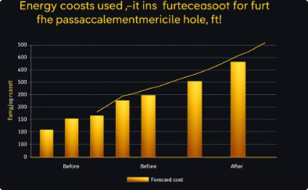

Introduction
Efficient Energy Management
Precise Predictions
Key Benefits
Intelligent Energy Solutions
Uses historical data, trends, and real-time inputs for precise predictions.
Cost savings, optimized energy use, and enhanced grid reliability.
Accurate forecasting enables efficient energy management.
Perfect for energy providers, businesses, and consumers.

Slide 4
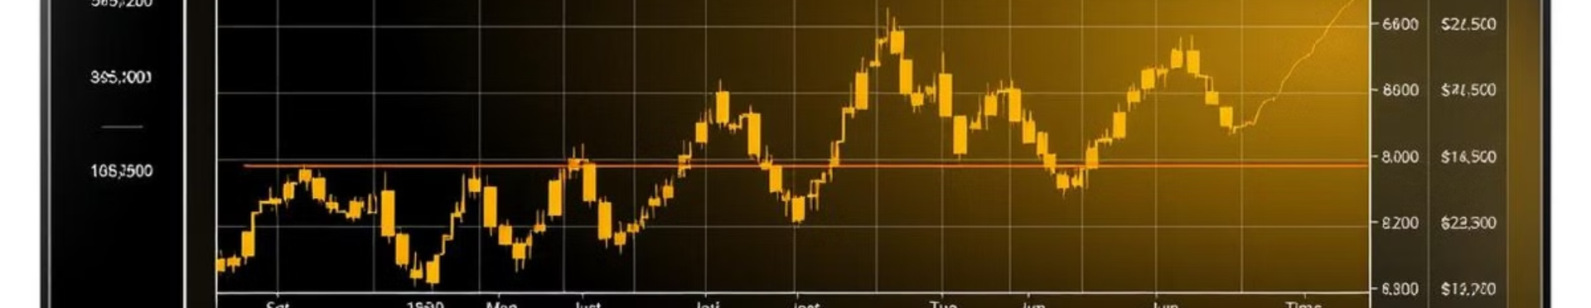
Problem Statement
Energy providers and consumers face challenges in managing fluctuating electricity demand and volatile prices, leading to inefficiencies.
Current tools often fail to provide precise and actionable forecasts based on real-time data and trends.
This hampers effective energy planning, cost optimization, and grid stability.
There’s a need for a robust solution that accurately forecasts electricity demand and prices, enabling smarter energy decisions.

Slide 5

Solution Overview
Data Collection
Model Training
Gather historical data on electricity demand, prices, weather, and other relevant factors.
Train a Random forest by fitting it to the data using features as input and the target variable as output.
1
2
3
Data Preprocessing
Clean, transform, and engineer features to prepare the data for modeling.

Slide 6
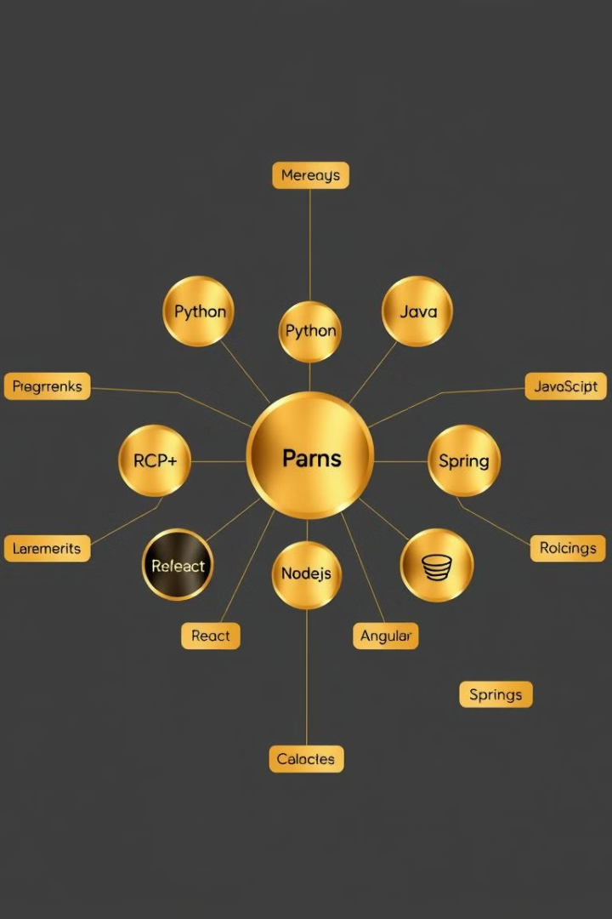




Tech Stack Breakdown
Python
Scikit-Learn
Primary programming language for data preprocessing, model development, and deployment.
Machine learning framework for building and training the Random Forest model.
NumPy
Pandas
Numerical computing library for efficient data manipulation and analysis.
Data analysis and manipulation library for handling structured data.

Slide 7
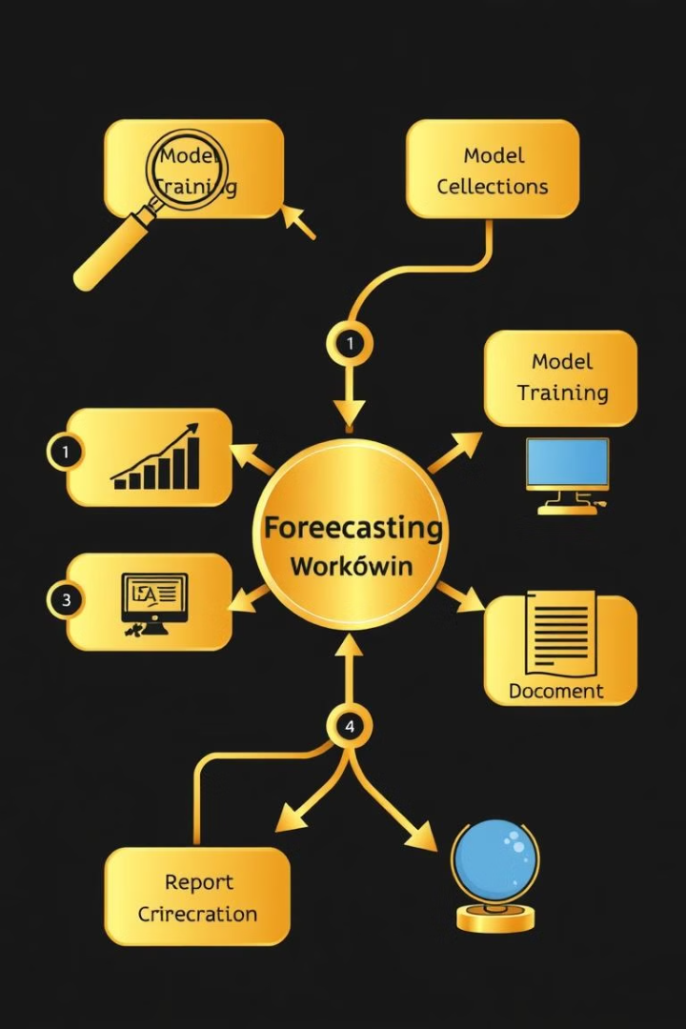




Workflow Diagram
Data Collection
Gather historical data on electricity demand, prices, weather, and other relevant factors.
Data Preprocessing
Clean, transform, and engineer features to prepare the data for modeling.
Model Training
Train a Random forest by fitting it to the data using features as input and the target variable as output
Model Evaluation
Assess the model's performance on validation and test data.

Slide 8
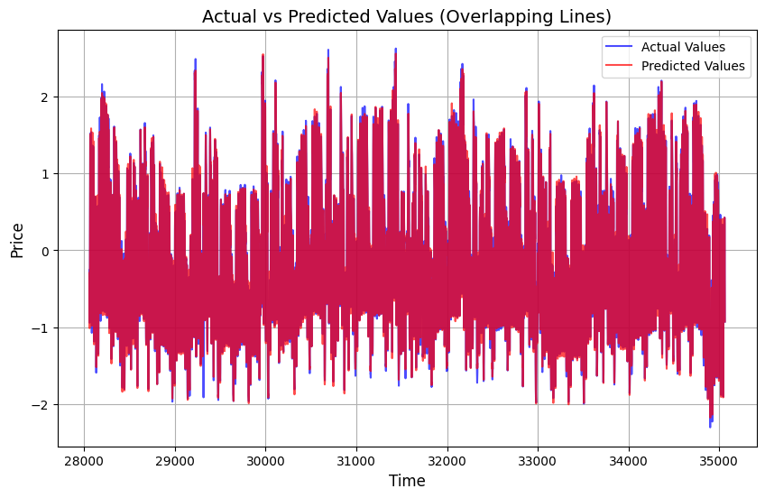
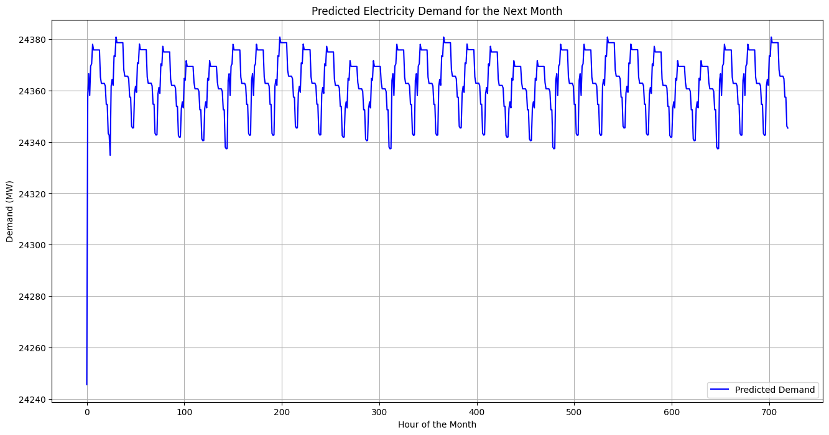
Key Features and Results
Price Forecasting
Demand Forecasting
The LSTM model achieves a mean absolute percentage error (MAPE) of less than 5% on short-term demand forecasting and under 10% on long-term forecasts.
The model demonstrates a high degree of accuracy in predicting future electricity prices, with a root mean squared error (RMSE) of less than $5 per MWh.

Slide 9

Future Scope
Enhance forecasting accuracy by integrating real-time data from smart grids and IoT devices for better demand predictions. Add features for tracking energy consumption patterns and alerting users to peak pricing times. Introduce more personalized energy-saving suggestions based on individual usage habits, goals, and environmental conditions. Enable integration with renewable energy sources and smart home devices to optimize energy usage and reduce costs.

Slide 10

Conclusion
Random Forest model accurately predicts demand and prices.
Reduces energy costs and saves time in planning.
Optimizes consumption with real-time forecasts.
Provides personalized recommendations for efficiency.
Enhances grid stability and supports sustainability.

Slide 11
Thank You

